Slide 1
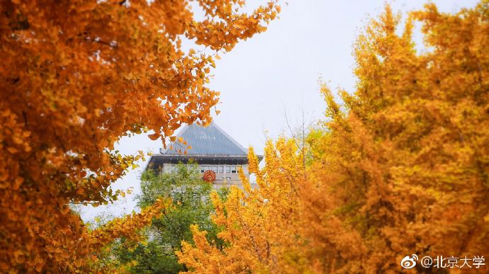

师大记忆
pku
BANGFER
Hebei Normal University

Slide 2
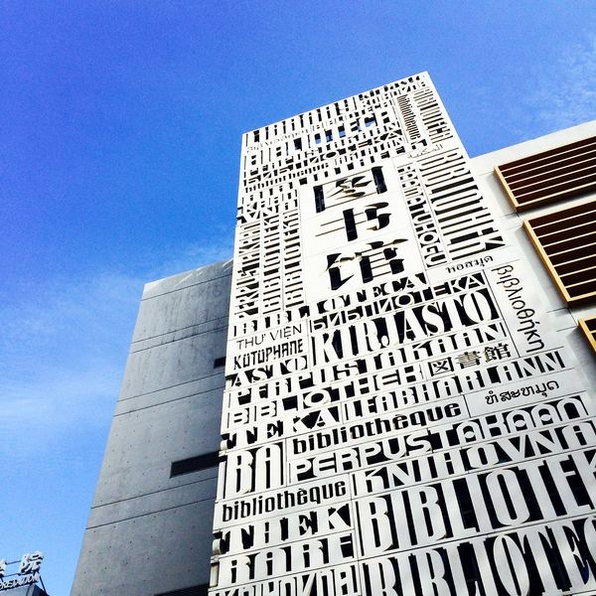
1
PART ONE
If you are ever in trouble, don't try to be brave, just run, just run away.
2
PART TWO
If you are ever in trouble, don't try to be brave, just run, just run away.
Contents
PART THREE
If you are ever in trouble, don't try to be brave, just run, just run away.
3
4
PART FOUR
If you are ever in trouble, don't try to be brave, just run, just run away.

Slide 3
THIS IS YOUR FUTUTE
01
PART.
I love you more than I've ever loved any woman. And I've waited longer for you than I've waited for any woman.I love you more than I've ever loved any woman. And I've waited longer for you than I've waited for any woman.
BAngfer

Slide 4
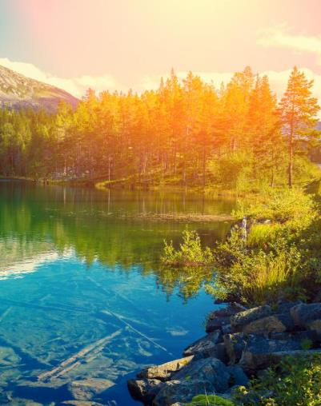
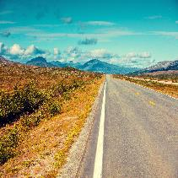
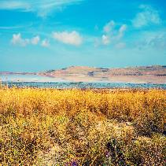
I love you more than I've ever loved any woman. And I've waited longer for you than
I love you more than I've ever loved any woman. And I've waited longer for you than
I've waited for any woman.I love you more than I've ever loved any woman. And I've waited longer for you than I've waited for any woman.
FUTURE

Slide 5
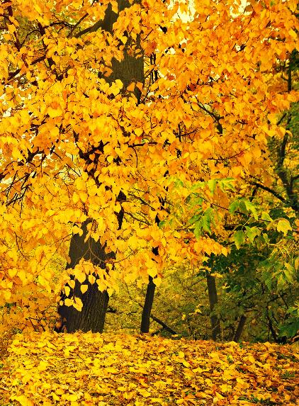
05
DESTINY FREEDOM
I love you more than I've ever loved any woman. And I've waited longer for you than I've waited for any woman.
I love you more than I've ever loved any woman. And I've waited longer for you than I've waited for any woman.I love you more than I've ever loved any woman. And I've waited longer for you than I've waited for any woman.
I love you more than I've ever loved any woman. And I've waited longer for you than I've waited for any woman.
I love you more than I've ever loved any woman. And I've waited longer for you than I've waited for any woman.I love you more than I've ever loved any woman. And I've waited longer for you than I've waited for any woman.

Slide 6
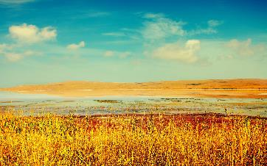
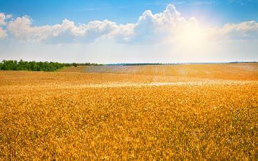
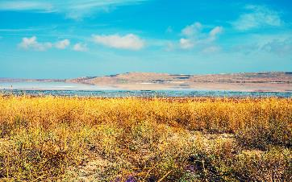
ALL OR NOTHING
NOW OR NEVER
I love you more than I've ever loved any woman. And I've waited longer for you than I've waited for any woman.I love you more than I've ever loved any woman. And I've waited longer for you than I've waited for any woman.
I love you more than I've ever loved any woman. And I've waited longer for you than I've waited for any woman.I love you more than I've ever loved any woman. And I've waited longer for you than I've waited for any woman.

Slide 7

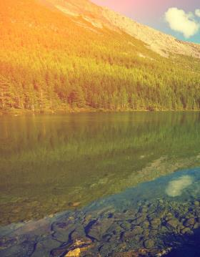
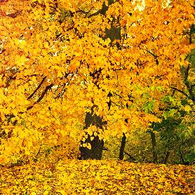
ALL OR NOTHING
NOW OR NEVER
I love you more than I've ever loved any woman. And I've waited longer for you than I've waited for any woman.I love you more than I've ever loved any woman. And I've waited longer for you than I've waited for any woman.
I love you more than I've ever loved any woman. And I've waited longer for you than I've waited for any woman.

Slide 8
THIS IS YOUR FUTUTE
02
PART.
I love you more than I've ever loved any woman. And I've waited longer for you than I've waited for any woman.I love you more than I've ever loved any woman. And I've waited longer for you than I've waited for any woman.
BAOTUWANG

Slide 9
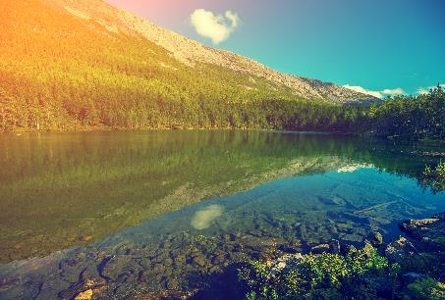
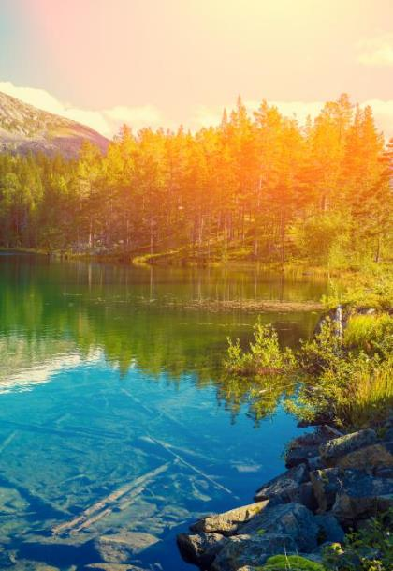
ALL OR
NOTHING
NOW OR
NEVER
DESTINY FREEDOM
I love you more than I've ever loved any woman. And I've waited longer for you than I've waited for any woman.I love you more than I've ever loved any woman. And I've waited longer for you than I've waited for any woman.
I love you more than I've ever loved any woman. And I've waited longer for you than
I've waited for any woman.I love you more than I've ever loved any woman. And I've waited longer for you than I've waited for any woman.

Slide 10
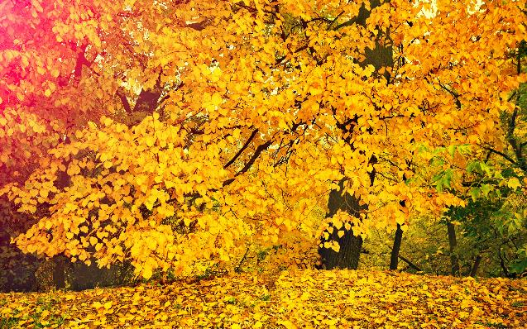
ALL OR NOTHING
NOW OR NEVER
I love you more than I've ever loved any woman. And I've waited longer for you than I've waited for any woman.I love you more than I've ever loved any woman. And I've waited longer for you than I've waited for any woman.
I love you more than I've ever loved any woman. And I've waited longer for you than I've waited for any woman.

Slide 11
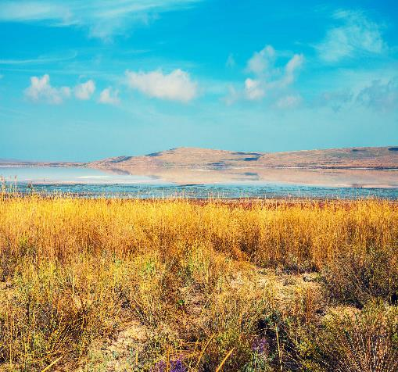
ALL OR NOTHING
NOW OR NEVER
I love you more than I've ever loved any woman. And I've waited longer for you than I've waited for any woman.I love you more than I've ever loved any woman. And I've waited longer for you than I've waited for any woman.
I love you more than I've ever loved any woman. And I've waited longer for you than
I've waited for any woman.I love you more than I've ever loved any woman. And I've waited longer for you than I've waited for any woman.

Slide 12
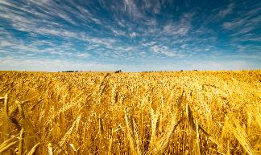
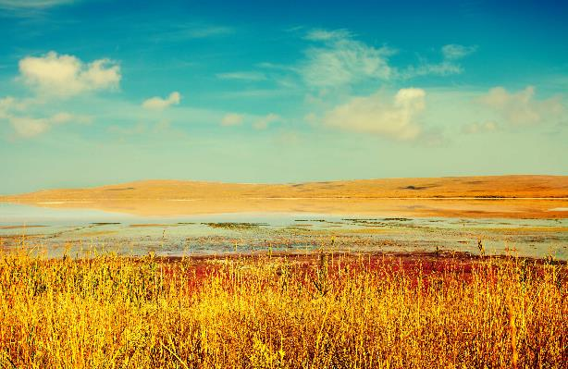

DESTINY FREEDOM
I love you more than I've ever loved any woman. And I've waited longer for you than I've waited for any woman.
I love you more than I've ever loved any woman. And I've waited longer for you than I've waited for any woman.I love you more than I've ever loved any woman. And I've waited longer for you than I've waited for any woman.

Slide 13
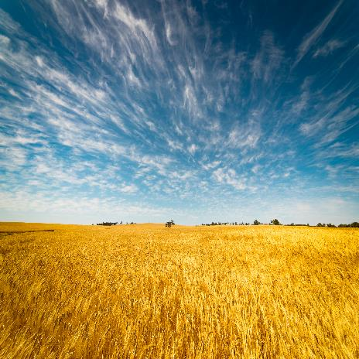
ALL OR NOTHING
NOW OR NEVER
I love you more than I've ever loved any woman. And I've waited longer for you than I've waited for any woman.
I love you more than I've ever loved any woman. And I've waited longer for you than I've waited for any woman.I love you more than I've ever loved any woman. And I've waited longer for you than I've waited for any woman.

Slide 14
THIS IS YOUR FUTUTE
03
PART.
I love you more than I've ever loved any woman. And I've waited longer for you than I've waited for any woman.I love you more than I've ever loved any woman. And I've waited longer for you than I've waited for any woman.
BAOTUWANG

Slide 15

ALL OR NOTHING
NOW OR NEVER
I love you more than I've ever loved any woman. And I've waited longer for you than I've waited for any woman.
I love you more than I've ever loved any woman. And I've waited longer for you than I've waited for any woman.I love you more than I've ever loved any woman. And I've waited longer for you than I've waited for any woman.

Slide 16
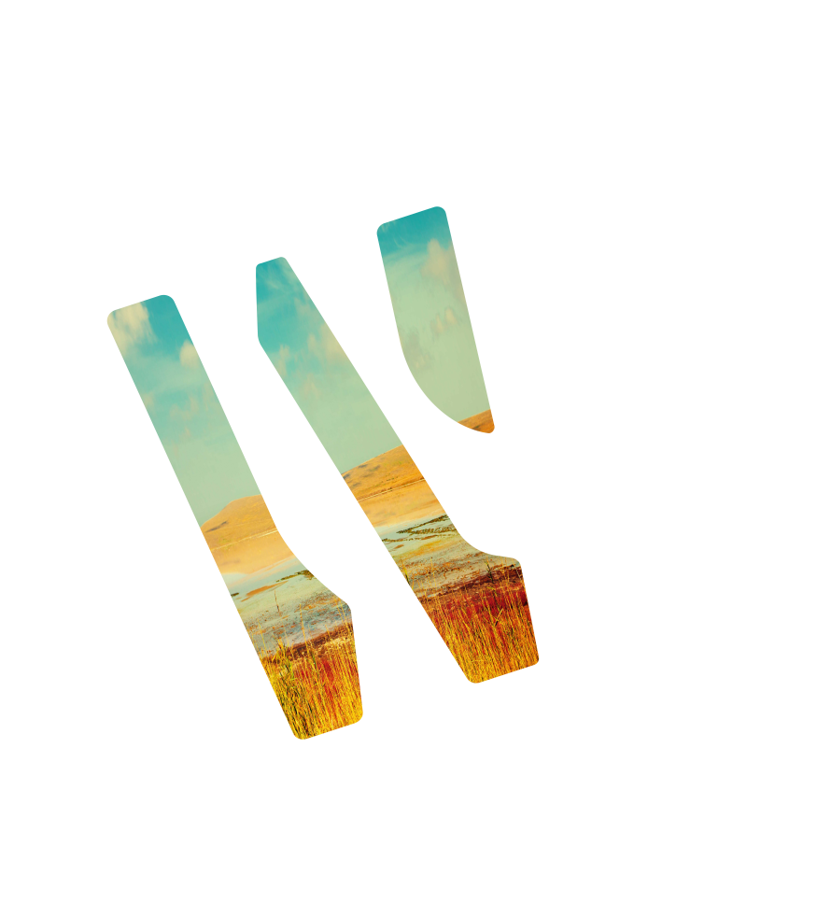
ALL OR NOTHING
NOW OR NEVER
I love you more than I've ever loved any woman. And I've waited longer for you than I've waited for any woman.
I love you more than I've ever loved any woman. And I've waited longer for you than I've waited for any woman.I love you more than I've ever loved any woman. And I've waited longer for you than I've waited for any woman.

Slide 17

ALL OR NOTHING
NOW OR NEVER
I love you more than I've ever loved any woman. And I've waited longer for you than I've waited for any woman.
I love you more than I've ever loved any woman. And I've waited longer for you than I've waited for any woman.I love you more than I've ever loved any woman. And I've waited longer for you than I've waited for any woman.

Slide 18
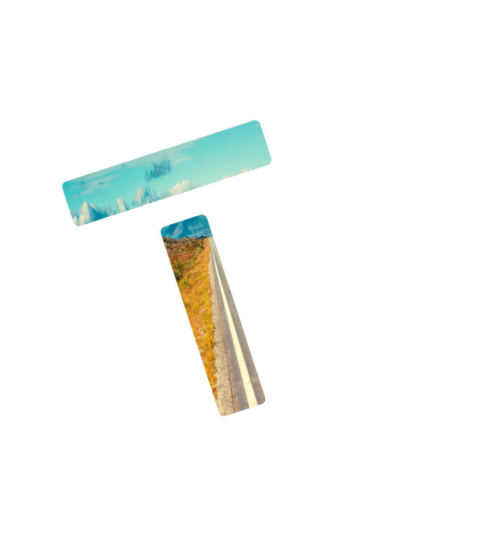
ALL OR NOTHING
NOW OR NEVER
I love you more than I've ever loved any woman. And I've waited longer for you than I've waited for any woman.
I love you more than I've ever loved any woman. And I've waited longer for you than I've waited for any woman.I love you more than I've ever loved any woman. And I've waited longer for you than I've waited for any woman.

Slide 19
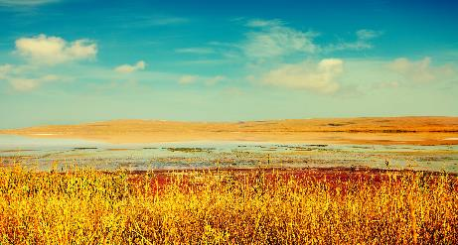

“
DESTINY FREEDOM
I love you more than I've ever loved any woman. And I've waited longer for you than I've waited for any woman.
I love you more than I've ever loved any woman. And I've waited longer for you than I've waited for any woman.I love you more than I've ever loved any woman. And I've waited longer for you than I've waited for any woman.
I love you more than I've ever loved any woman. And I've waited longer for you than I've waited for any woman.
“

Slide 20
THIS IS YOUR FUTUTE
04
PART.
I love you more than I've ever loved any woman. And I've waited longer for you than I've waited for any woman.I love you more than I've ever loved any woman. And I've waited longer for you than I've waited for any woman.
BAOTUWANG

Slide 21
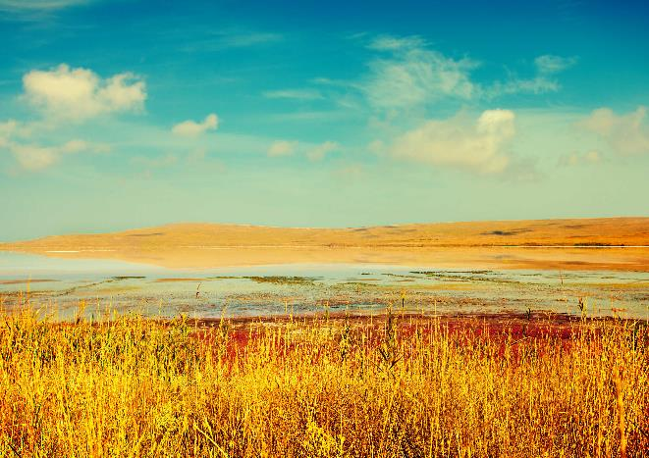
ALL OR NOTHING
NOW OR NEVER
I love you more than I've ever loved any woman. And I've waited longer for you than I've waited for any woman.
I love you more than I've ever loved any woman. And I've waited longer for you than I've waited for any woman.
DESTINY FREEDOM
I love you more than I've ever loved any woman. And I've waited longer for you than I've waited for any woman.I love you more than I've ever loved any woman. And I've waited longer for you than I've waited for any woman.

Slide 22
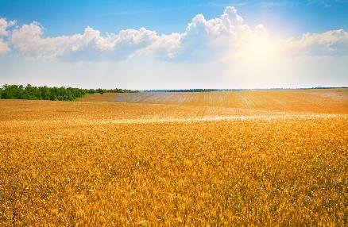

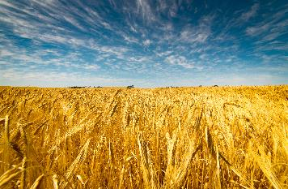
DESTINY FREEDOM
I love you more than I've ever loved any woman. And I've waited longer for you than I've waited for any woman.
I love you more than I've ever loved any woman. And I've waited longer for you than I've waited for any woman.I love you more than I've ever loved any woman. And I've waited longer for you than I've waited for any woman.
I love you more than I've ever loved any woman. And I've waited longer for you than I've waited for any woman.

Slide 23
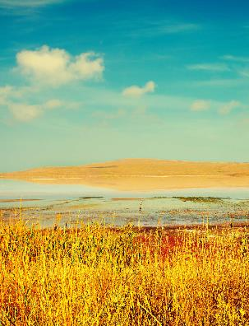
ALL OR NOTHING
NOW OR NEVER
DESTINY FREEDOM
I love you more than I've ever loved any woman. And I've waited longer for you than I've waited for any woman.
I love you more than I've ever loved any woman. And I've waited longer for you than I've waited for any woman.

Slide 24
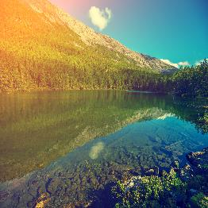

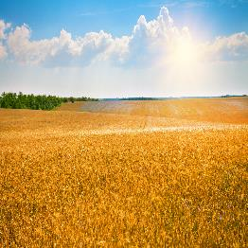
ALL OR NOTHING NOW OR NEVER
DESTINY FREEDOM
DESTINY FREEDOM
DESTINY FREEDOM
I love you more than I've ever loved any woman. And I've waited longer for you than I've waited for any woman.
I love you more than I've ever loved any woman. And I've waited longer for you than I've waited for any woman.
I love you more than I've ever loved any woman. And I've waited longer for you than I've waited for any woman.

Slide 25

THANKS FOR YOUR WATCHING
pku

